Slide 1
Building Bridges Across Faith Communities
CTS Pastors’ Experience
Rabbi Dr. Rachel S. Mikva
Herman Schaalman Chair in Jewish Studies
InterReligious Institute, Senior Faculty Fellow

Slide 2
Where does interreligious engagement happen?

Slide 3
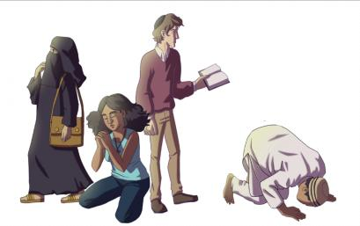
Where does interreligious engagement happen?
At places of work
Through the media
Via internet
Within families
On campuses
Within congregations
Between congregations, community organizations, etc.
AND…?

Slide 4
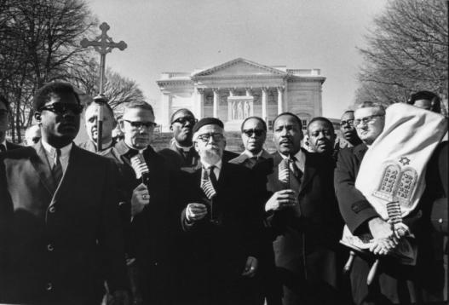
Starting with you
What has been your experience with interreligious engagement?

Slide 5
What is the value of Interreligious Engagement?

Slide 6
What is the value of Interreligious Engagement?
Fight bigotry and create understanding across religious difference.
Gather partners in the work of social transformation.
Establish relationships that can defuse religious tensions and protect besieged communities.
Increase religious literacy, including an appreciation for how others see/hear us.
Deepen our self-understanding and spiritual commitments.
AND…?
Psalm 133:1-Behold, how good and how pleasant it is for us to dwell together in unity!
Notes:
Not going to take time to make case for importance of IR Engagement.

Slide 7
What are the barriers to building bridges?

Slide 8
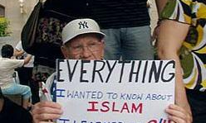
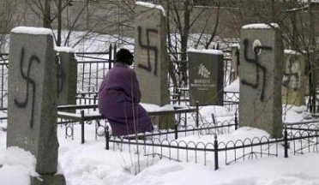
What are the barriers to building bridges?
Fear
Ignorance
Competing priorities
Lack of religious diversity in your community
Lack of support in your own community
Not having tools or ideas
AND…?

Slide 9
Modes of engagement

Slide 10
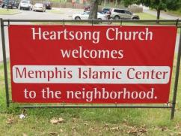
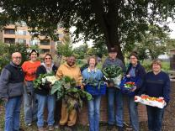
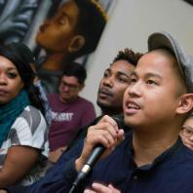
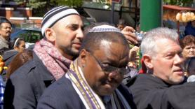
Social Justice – Service Learning
Cooperative congregational projects: advocacy and service
Congregation-based community organizing
-Soup kitchens, food pantries, community gardens
-Gathering voices to speak up for local concern
-Emergency shelter
-Food/clothing/toy drives
-Make-a-difference day
-March, protest, prayer vigil
-Get out the vote
-Letter-writing campaign
-Actions of solidarity
Notes:
Familiar mode

Slide 11
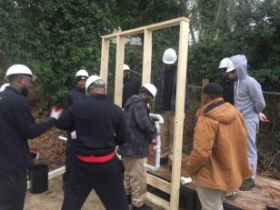
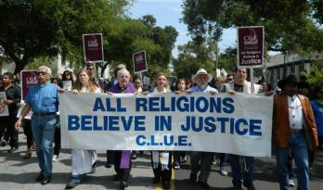
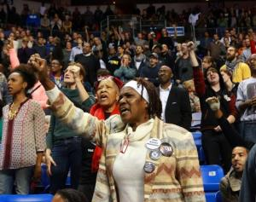
Social Justice – Service Learning
Interfaith social justice organizations
Individual faith-based organizations in partnership
Organizing Against Police Violence
Faith-based ReEntry Projects: Inner-City Muslim Action Network, Healing Communities, ReEntry Family and Faith Circles of Support
IMAN Green ReEntry
Interfaith Worker Justice,
Clergy and Laity United for Economic Justice

Slide 12
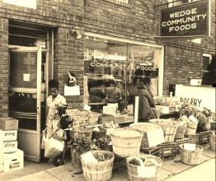
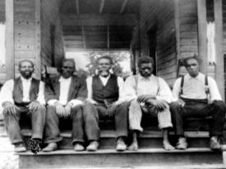
Social Justice – Service Learning
Crisis intervention
Non-institutional partnerships
Cooperative buying

Slide 13
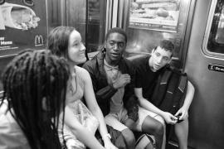
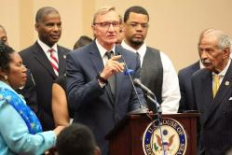
Social Justice – Service Learning
Issue-oriented interreligious learning & study tours
Blogging, cyber-activism and networking
Church-Synagogue Joint Youth Group
Civil Rights tour
New Evangelical Partnership
Networking on Criminal Justice Reform,
Creation Care, and Interfaith Dialogue
What Religion Really Says About Anti-LGBTQ Discrimination
By Homayra Ziad, Rachel S. Mikva, and Phyllis Pennese
Notes:
Familiar mode

Slide 14
Social Justice – Service Learning
AND…?
Notes:
Familiar mode

Slide 15
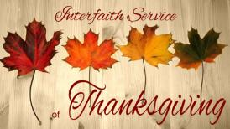
Prayer and Ritual
Interfaith worship (e.g. Thanksgiving, prayer vigils, in response to community crisis)—particular expressions or common ground
Pulpit exchanges
Visiting for worship or ritual observance (seder, iftar)
Creative ritual (Read-the-Quran Day, reimagined rituals for interfaith families)
Retreats (women, themed)
AND…?
What Unites Us Is Greater

Slide 16
Engagement through the Arts
Exposure with opportunity for discussion: Film showings/festivals Theatrical performance
Collective Arts and Music Festivals
Café Finjan, Takin' It to the Streets , Sounds of Faith
Collaborative Arts and Music Projects
Same Difference, Shalom2Salaam, Poetry Pals
Comedy
Funatical, The Israel-Palestine Comedy Tour
AND…?

Slide 17
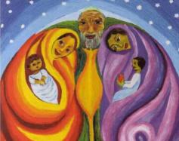
Education and Dialogue
Lectures, Panels, Workshops and Symposia
Book groups
Mini-courses
Text study (Scriptural Reasoning)
Women’s or other affinity groups
Dialogue/study groups
Storytelling (personal and traditional)
List serve, Facebook, other social network
AND…?
Storytelling
in the religious traditions of
Abraham, Sarah and Hajar
“Sometimes the way the story
goes depends on who tells it.”
-Janice DelNegro
Notes:
Not addressing passive resource (webpage w/resources, etc.) – tho something like HuffPost becomes in IR blogging community

Slide 18
Education and Dialogue
Contrary to much binary thinking that says only one way is right:
Within your community and between communities
With clergy representing (or other professionals), and participants speaking together
What you can teach, and what adherents should teach
One-shot deals and deep learning
Exposure/encounter, and building long-term relationships

Slide 19
Some things you could teach within your community
Christian theologies of pluralism, e.g.
Divinity and Diversity, Marjorie Hewitt Suchocki
Making a Way Out of No Way: A Womanist Theology, Monica Coleman
Monopoly on Salvation? A Feminist Approach to Religious Pluralism, Jeannine Hill-Fletcher
And socially-based religious pluralism, e.g.
Harvard Pluralism Project
Sacred Ground, Eboo Patel

Slide 20
Within your community, part 2
Jesus as a Jew
The Misunderstood Jew, A.J. Levine
Jesus of Nazareth, King of the Jews: A Jewish Life and the Emergence of Christianity, Paula Fredricksen
The Jewish Gospels, Daniel Boyarin
Dismantling anti-Muslim bias
Islam and the Blackamerican, Sherman Jackson
Muslims in America, Edward E. Curtis IV
Fear, Inc. 2.0 Report
Southern Poverty Law Center Anti-Hate Project

Slide 21
Within your community, part 3
Introduction to Islam
-No God But God: The Origins, Evolution and Future of Islam, Reza Aslan
-The Story of the Qur’an: Its History and Place in Muslim Life, Ingrid Mattson
-In the Footsteps of the Prophet: Lessons from the Life of Muhammad, Tariq Ramadan
-The Bible and the Qur’an: Biblical Figures in the Islamic Tradition, Younus Mirza and John Kaltner

Slide 22
Tools/rules for engagement

Slide 23
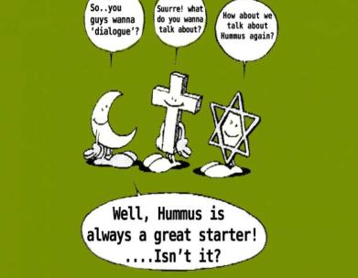
Cultivate common ground AND Dignify difference
There is a tendency to seek out the many examples of beautiful harmony among religious teachings that exist.
There is a tendency to seek out “lowest common denominator” when praying or learning together.
There is a tendency to avoid difficult issues.
People come will all manner of identities: race, gender, sexuality, class….
Seek out ways to recognize and celebrate particularity and difference as well.
Once there is relationship and trust, tackle the tough stuff too

Slide 24
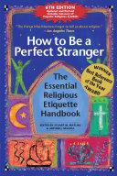
Learning
Disinterest is not a sign of respect.
Learn enough to engage with sensitivity, and to have intelligent questions.
Admit what you don’t know, and make room for yourself and others to grow.

Slide 25
Relationships matter
Personal narratives are very important in building relationships and effective in fashioning understanding—even if/when the religious “information” is imperfect.
Be proactive. Build relationships now, so they are there when it matters. Make time to nurture them.
We still can/should react when crisis or conflict unfolds, but then build on that momentum.
Read the Qur’an Day, Gainesville FL
Billings MT 1993 “Christmas Menorahs”
Ramadan fundraiser to rebuild black churches

Slide 26
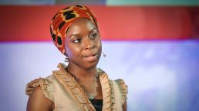
Danger of the single story
No individual can represent the entire religious tradition.
Intra-faith engagement is also essential.
People should be encouraged to speak in “I” statements.
This does not mean that no one can teach “about,” but religious traditions are diverse and multivocal. “-Isms,” at best, describe a portion of the community, and sometimes do not reflect actual belief and praxis.
Media frequently feeds us a “single story” of minority traditions in the U.S.
Chimamanda Ngozi Adichie

Slide 27
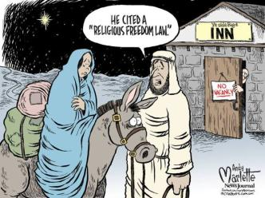
Engagement among equals
YOU NEED PARTNERS! That means people and organizations who are in on the planning, and with whom you commit to ongoing relationship.
POWER can be out of balance due to many factors: size of community, financial situation of organization, knowledge, experience, etc.—as well as the basic context of Christian privilege.
CONTEXT will shape power dynamics of the moment (host, issue, need to learn about minority tradition).

Slide 28
Be accountable to one another
Only the members of a particular faith tradition can know what it is to be a member of that community.
Be cautious (and consult) when drawing parallels to other traditions; avoid misrepresentation and stripping of uniqueness.
What you say about your own tradition implicates others.
Practice “holy envy,” a profound appreciation of other religious traditions and their unique beauty—without appropriation.
Enagement often deepens our own religious commitments, but the point of meeting can never be “all about me.” We can’t erase the significance of the individuals and traditions we encounter.

Slide 29
Think more broadly about religion… and include the “non-religious”
Programs can select dialogic or trialogic focus; they do not always need to be all-inclusive.
When you are being inclusive, remember that not all traditions are monotheistic, or even theistic—and not everyone fits into a tidy box.
“Common language” may require more consultation, consideration and learning. (Often times, enabling multiple particular expressions works better.)
Include the non-religious in your outreach and brainstorming – and NOT with the agenda to draw them into the church.
Chris Steadman, author of Faitheist

Slide 30
Honesty (duh)
Honesty builds trust.
Resist the tendency to view your own tradition in its ideal form, and them compare that to what you “see” of the actual practice of another tradition.
Not all people have the same social or theological capacity for self-critique.
Acknowledge mistakes… and injuries.
Let reproof take the form of struggle (call in vs. call out).
Let struggle be received with empathy.

Slide 31
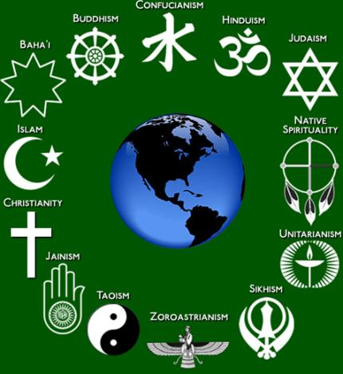
Better Together Day Project Spirit (start 4:13)

Slide 32
